Slide 1
FreeBies For NewBies
Android Application

Slide 2
Team Members
Jaichand Mulakalapalli
(TEAM LEADER) BACKEND
Manoj kumar gude
FRONTEND
Adithya krishna raavi
FRONTEND
Saibabu devarapalli
Fullstack
Harish Chowdary bala
DATABaSE administrator

Slide 3
Freebies for Newbies
Project Description:
This app helps International Students to register themselves as users to update new events and get access to all the events(cultural, sports and food) that are free of cost and also helps users to find free items in their locality. find nearby free items.
Mentor & Client:
Dr. Chandra Mouli Kotteti

Slide 4
Why Android?
Wider pool of customers
User friendly
Easier installation
Easier entry to the market
Compatible with more devices
Lower development costs

Slide 5
Android Studio
Android Studio is the official Integrated Development Environment (IDE)
Android studio provides environment to built android apps for mobiles phones, desktops, tablets etc..,
Structured code modules allow you to divide your project into units of functionality that you can independently build, test, and debug.
Android apps can be written using Kotlin, Java, and C++ languages.
Android Application = Code + Resources

Slide 6
Application fundamentals
The Android operating system is a multi-user Linux system in which each app is a different user.
By default, the system assigns each app a unique Linux user ID (the ID is used only by the system and is unknown to the app). The system sets permissions for all the files in an app so that only the user ID assigned to that app can access them.
Each process has its own virtual machine (VM), so an app's code runs in isolation from other apps.
By default, every app runs in its own Linux process. The Android system starts the process when any of the app's components need to be executed, and then shuts down the process when it's no longer needed or when the system must recover memory for other apps.

Slide 7
App Components
App components are the essential building blocks of an Android app. Each component is an entry point through which the system or a user can enter your app. Some components depend on others.
There are four different types of app components:
Activities
Services
Broadcast receivers
Content providers

Slide 8
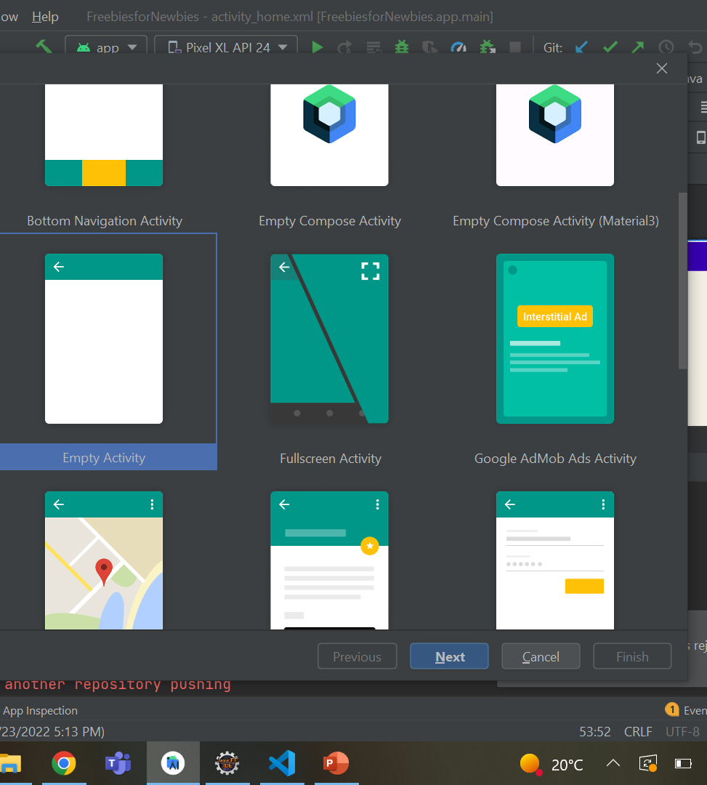
Activity
An activity is the entry point for interacting with the user. It represents a single screen with a user interface.
For example, an email app might have one activity that shows a list of new emails, another activity to compose an email, and another activity for reading emails.
Keeping track of what the user currently cares about (what is on screen) to ensure that the system keeps running the process that is hosting the activity.
Providing a way for apps to implement user flows between each other, and for the system to coordinate these flows.
Fig 1. Predefined Activities

Slide 9
Services
A service is a general-purpose entry point for keeping an app running in the background for all kinds of reasons.
It is a component that runs in the background to perform long-running operations or to perform work for remote processes.
A service does not provide a user interface.
There are two types of services that tell the system how to manage an app: started services and bound services.

Slide 10
Broadcast Receivers
A broadcast receiver is a component that enables the system to deliver events to the app outside of a regular user flow, allowing the app to respond to system-wide broadcast announcements.
Because broadcast receivers are another well-defined entry into the app, the system can deliver broadcasts even to apps that aren't currently running.
For example, an app can schedule an alarm to post a notification to tell the user about an upcoming event... and by delivering that alarm to a BroadcastReceiver of the app, there is no need for the app to remain running until the alarm goes off.

Slide 11
Content Providers
A content provider manages a shared set of app data that you can store in the file system, in a SQLite database, on the web, or on any other persistent storage location that your app can access.
Through the content provider, other apps can query or modify the data if the content provider allows it.

Slide 12
Features
A flexible Gradle-based build system
A emulator to run your code
A unified environment where you can develop for all Android devices
Apply Changes to push code and resource changes to your running app without restarting your app
Lint tools to catch performance, usability, version compatibility, and other problems

Slide 13
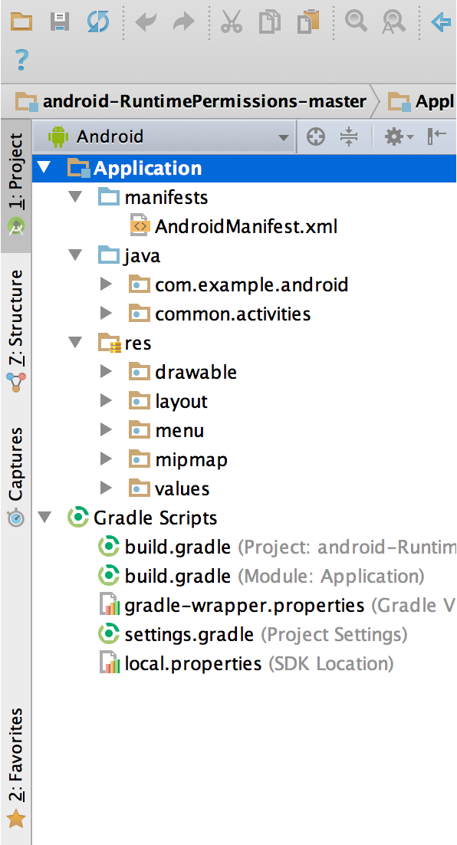
Project Structure
By default, Android Studio displays your project files in the Android project view, as shown in figure 1. This view is organized by modules to provide quick access to your project's key source files.
All the build files are visible at the top level under Gradle Scripts and each app module contains the following folders:
Manifests : Contains the AndroidManifest.xml file
java: Contains the Java source code files, including JUnit test code.
res: Contains all non-code resources, such as XML layouts, UI strings, and bitmap images.
Fig 2. The project files in Android view.

Slide 14
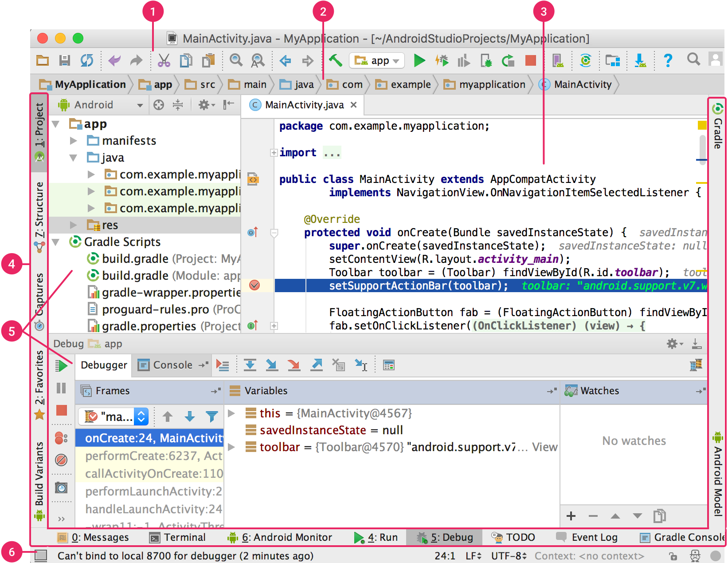
User Interface
1 - The toolbar lets you carry out a wide range of actions, including running your app and launching Android tools.
The navigation bar helps you navigate through your project and open files for editing. It provides a more compact view of the structure visible in the Project window.
The editor window is where you create and modify code. Depending on the current file type, the editor can change. For example, when viewing a layout file, the editor displays the Layout Editor.
The tool window bar runs around the outside of the IDE window and contains the buttons that allow you to expand or collapse individual tool windows.
The tool windows give you access to specific tasks like project management, search, version control, and more. You can expand them and collapse them.
The status bar displays the status of your project and the IDE itself, as well as any warnings or messages.
Fig 3. Android Studio and its components

Slide 15
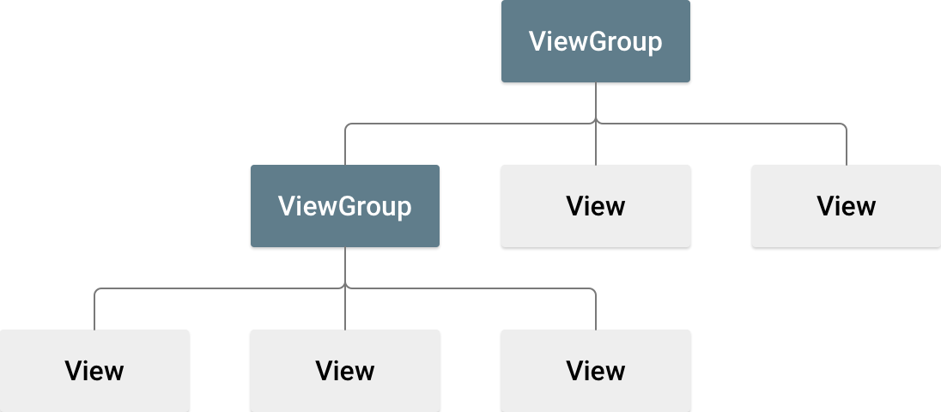
Layouts
Layout defines structure of User Interface in your app.
All Elements in the layout are built using the hierarchy of View and View group Objects.
View is a physical interface that interacts with the user.
View Group Objects are pointed to another views and View group objects.
View Objects are called as Widgets and like one of many subclasses (Button , Text View , etc. ).
View group Objects provide different layout structure.(Linear layout , Constraint Layout)

Slide 16
Layouts
The layouts can be designed in two different ways.
Declaring the UI elements at run time.
Declare the UI Elements in XML.
We can also use Android studio Layout Editor to build your XML layout using the drag and drop interface.
It controls the behavior of apps and it is easy to maintain the layouts for different screen sizes.
First declare the layout in the XML format and save it with .xml extension in res/layout for avoiding errors.
Load the XML Resource.
a. Attributes.
b. IDs
Layout Parameters :-
View group class contains a nested class called ViewGroup.LayoutParms. It defines size and position for each child group.

Slide 17
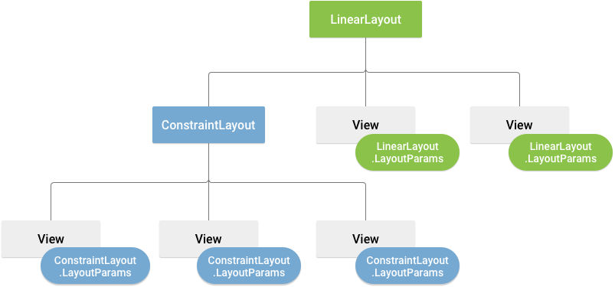
Visualization of a view hierarchy with layout parameters associated with each view
Every View group class implements a nested class that extends ViewGroup.LayouParms This subclass contains size and position of each child view. Each child must define layout parms for its parent. It can define its own Layout Parms to its own children. Layout Params subclass has its own syntax for setting values Wrap content tells your view to size itself to the dimensions required by its content. Match parent tells your view to become as big as its parent view group will allow. Layout positions can be adjusted by adding some methods. Size, Padding and margins can also be added to layouts.

Slide 18


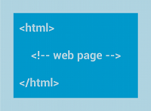
Common Layouts
Each sub class of view group class provides its own way of embedding the views in it.
Below are some common layout types that are built in android platform.

Slide 19

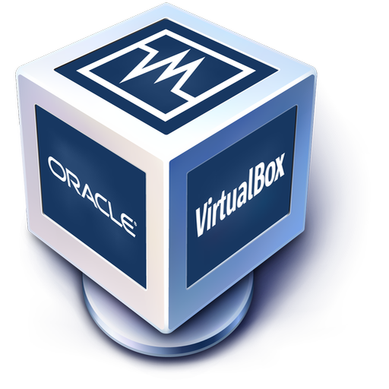

Tools
Eclipse
Oracle VirtualBox
Genymotion

Slide 20
What & Why Genymotion
Genymotion is a front-end app that hooks into the VirtualBox software API and gives you advanced emulation and development features
It also has a portal where you log into and download pre-formatted virtual machines already configured with various popular distros of Android OS.
Genymotion is a popular Android emulator based on VirtualBox
If you play heavy-duty 3D graphic games, such as PUBG Mobile, which require 2 GB or more of space
Genymotion lets you experience them on a larger laptop or desktop without performance issues.

Slide 21
Versions of Android Mobiles
Android 5.1(Lollipop)
Marshmallow 6.0
Nougat 8.0
Oreo 8.1
Oreo 8.0
Pie 9.0
Q 10.0

Slide 22
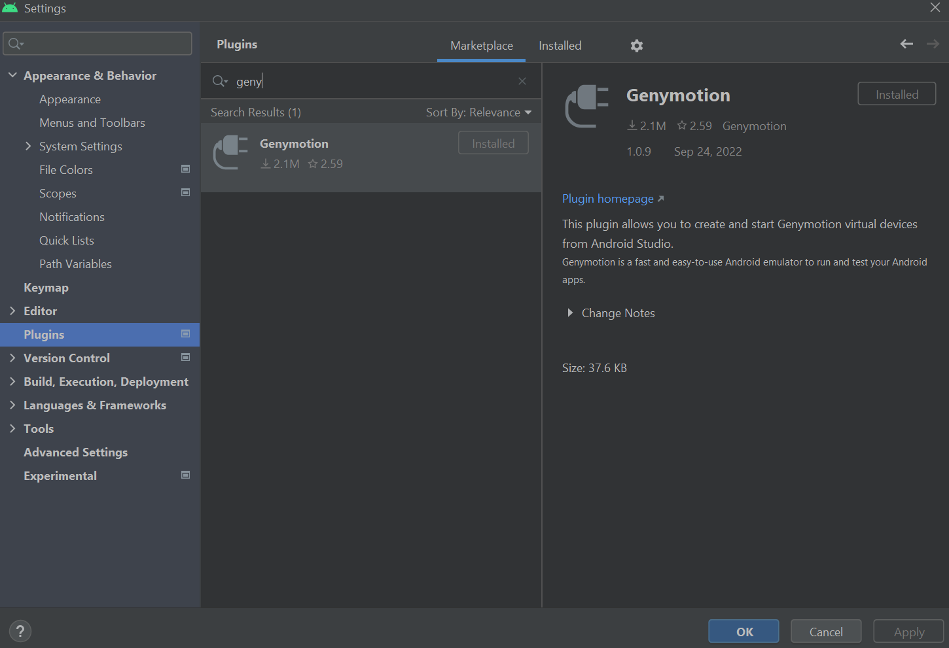
Connecting Genymotion to android studio
For this first you must install the genymotion in your system.
To connect genymotion into your account you must install the genymotion plugins.
For this go to settings in android studio, select plugins and type genymotion in the search box
Click on install and apply ok. Then you can connect the genymotion virtual device by using device manager.
Fig 5. Genymotion

Slide 23
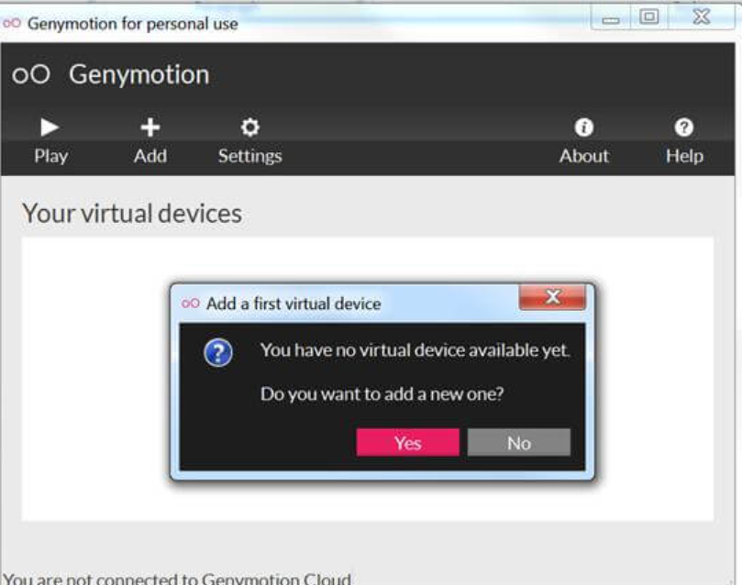
Steps to add genymotion to android
Create and login to genymotion account
Creating new virtual device to run your application.
To add new virtual device, click on add button.
Fig 6.a. Adding a new device in Genymotion

Slide 24
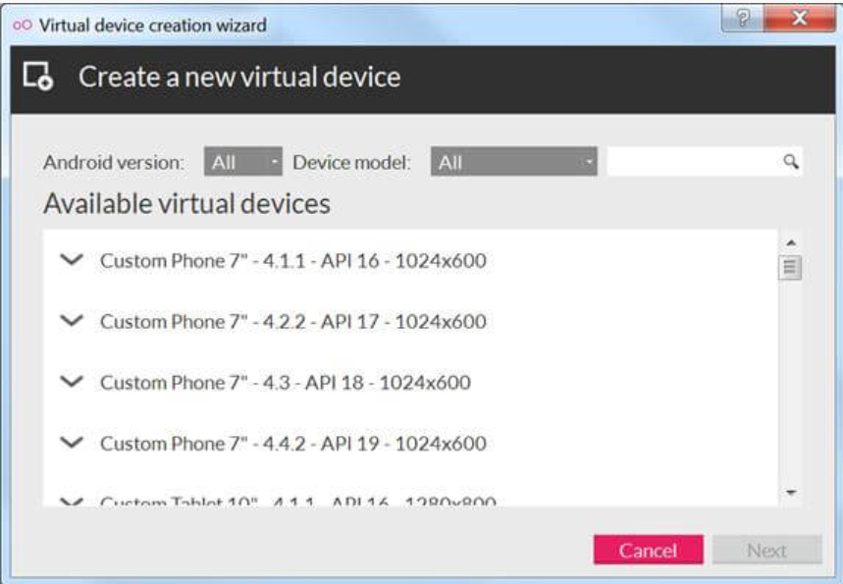
Setting up device in genymotion
If you click on add button , you can see the window as like as given figure
You can various devices with various device evolutions
Each device there will be different properties
Based upon the properties we will select the device
Fig 6.b. Adding a new device in Genymotion

Slide 25
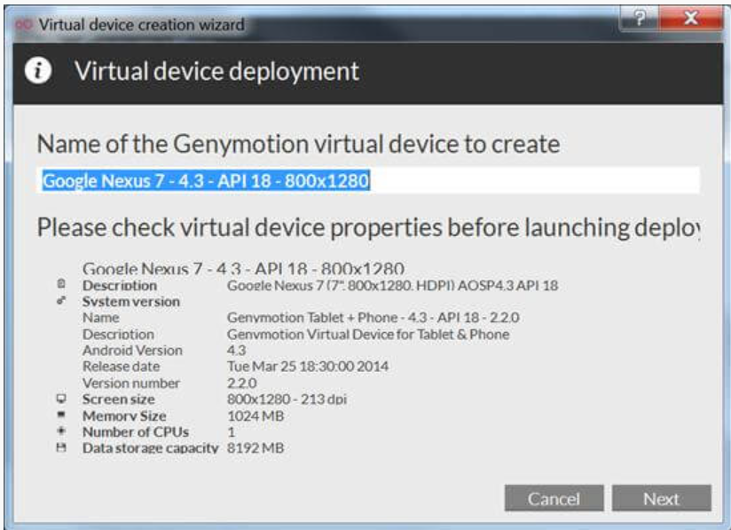
Check Virtual device properties
Please check with properties of your virtual device, before deploying it.
Under the device there will be properties like :
Description of device
System versions
Android version
Screen size
Memory size
Data storage capacity
Number of CPU
Fig 6.c. Adding a new device in Genymotion

Slide 26
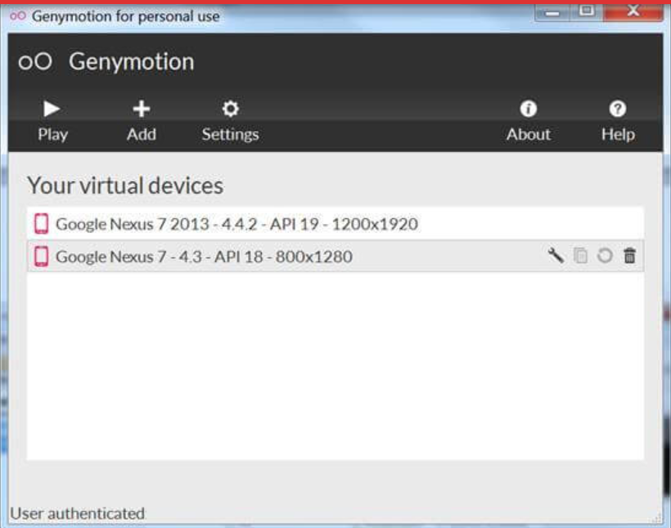
Start your virtual device
Once you added all the properties, you can see the device in home.
You can see the option like start device , delete device and edit the properties.
If you click the start device, the device will be started.
If you click on delete device, the device will be deleted.
If you click on the edit properties, you edit system versions, screen size , memory size and android version.
Fig 7. Newly added device in Genymotion

Slide 27

Firebase Database
Firebase is a mobile and web application development platform developed by Firebase, Inc.in 2011, then acquired by google in 2014.
Firebase has supported for the web, IOS, android.
Firebase Database integration in IOS, web, android is quite simple by adding its configuration files and SDKs in required platforms.
Firebase automatically generate Server-side code. It is for anybody that wants to write apps without having to run backend server or write server code.
Features :
1. Authentication
2. Database
3. Storage
4.Hosting
5.Cloud messaging

Slide 28
Firebase Authentication
Reduce the function with robust authentication.
Firebase UI – provides a drop in auth solution that handles the UI flows for signing in users with email address and passwords, google sign-in and Facebook login, Git hub sign in.
E-mail & Password Authentication.
Custom Auth integration.
Anonymous Auth- Use Firebase features that require authentication without requesting users to sign in in first by creating temporary anonymous accounts. If the user later choose to sign-up, you can upgrade the anonymous account to a regular account. So that user can continue where they left off.
In additional to SDK’s firebase also provides libraries to handle lot of the tricky parts of authentication like , password recovery and email.

Slide 29
Firebase Features
DATABASE : It provides a real-time database and backend as a service. It stores and sync app data in real time. It access directly from your app.
Storage : Stores files with ease. Firebase is a backend -as-a-service, which allows us to store a list of objects in the form of a tree.
Hosting : Deliver web content faster. Firebase Hosting is a fully-managed hosting service for static and dynamic content as well as microservices
Cloud Messaging : Deliver and receive messages across platforms reliably.
Run a few scripts to perform actions on the Firebase database, such as writing data to it, creating Firebase references, and reading data from it. It won't be necessary to write code with extra lines.
Additionally, it will map every piece of data to a URL, When something changes, updates are pushed in milliseconds.
Security Consideration : Security rules stored and executed server side.

Slide 30
Commands :
var ref = firebase.database().ref('/some/path');
var obj = {someAttribute: true};
ref.push(obj); // Creates a new ref with a new "push key"
ref.set(obj); // Overwrites the path ,
ref.update(obj); // Updates only the specified attributes
The most straightforward way to save data is ref.set(). It overwrites the ref with whatever object you pass it.
ref.push(obj) - create a new ref with an automatically generated push key.
To update some keys without blowing away an entire object, use ref.update(). You could do something like userRef.update({timestamp: 123456789}); and overwrite only the timestamp attribute of userRef.
This NoSQL database makes it easy for programmers to transfer and store data for front and backend development.
For Storing data and retrieving data we need to write only few lines of code.
Because of all these features, using Firebase Database for creating applications in Android Studio is strongly advised.

Slide 31
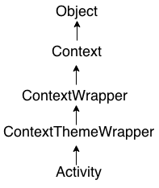
Android Activity Lifecycle
It is controlled by 7 methods of android.app.Activity class.
The android Activity is the subclass of ContextThemeWrapper class.
An activity is the single screen in android. It is like window or frame of Java.
By the help of activity, you can place all your UI components or widgets in a single screen.

Slide 32
Android Activity Lifecycle
Table 1: Lifecycle methods of android activity.
Method | Description
onCreate | called when activity is first created.
onStart | called when activity is becoming visible to the user.
onResume | called when activity will start interacting with the user.
onPause | called when activity is not visible to the user.
onStop | called when activity is no longer visible to the user.
onRestart | called after your activity is stopped, prior to start.
onDestroy | called before the activity is destroyed.

Slide 33
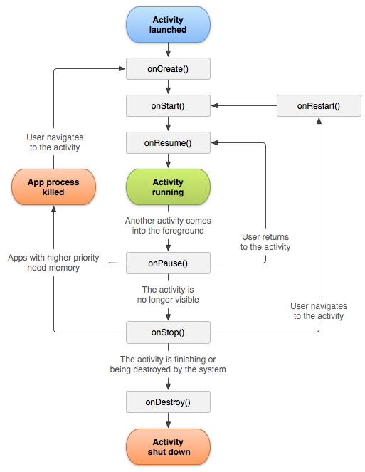
Android Activity Lifecycle
Fig 8. A simplified illustration of the activity lifecycle.

Slide 34
Lessons Learned:
The best thing about Android app development is that you can learn easily.
There are numerous amounts of resources available for Android app development on the web.
Improve problem-solving skills as well as overcome all the hurdles and flaws when implementing your solution on your own or with a team.
Android is one of the tremendous platforms where you enhance your creative and innovative thinking.

Slide 35

Thank you everyone..!

Slide 36
Summary
In this presentation we have covered basic concepts and components to design and implementation of a mobile application.
Android is open to all: industry, developers and users.
Our team has cover most of the essential parts of the Android Studio, Genymotion and database:
Introduction to the tools used to develop android application.
Activities and its lifecycles, Intents etc.,
Importance of emulators and other database tools.

Slide 37
FreeBies For NewBies
Android Application

Slide 38
Team Members
Jaichand Mulakalapalli
(TEAM LEADER) BACKEND
Manoj kumar gude
FRONTEND
Adithya krishna raavi
FRONTEND
Saibabu devarapalli
Fullstack
Harish Chowdary bala
DATABaSE administrator

